Slide 1

Beginner’s Workshop
Paul Lammertsma
CTO, Pixplicity

Slide 2
Agenda
10:00 Introduction
10:30 Lesson #1
11:30 Lesson #2
12:30 Lunch
13:30 Lesson #3
14:30 Lesson #4
15:30 Lesson #5
16:30 Homework

Slide 3
Contents
Introduction
Lesson #1 Android Studio & projects
Lesson #2 Activities & Views
Lesson #3 Intents, Tasks & Activity Back Stack
Lesson #4 ListViews & Adapters
Lesson #5 All together now! An image viewing app
Homework

Slide 4
NON-Contents
The Java language and syntax
Basic Object Oriented (OO) programming
Basic event driven programming
Writing tests
Working with more complex concepts
Services, Broadcast Receivers, Databases, etc.

Slide 5
Why Android?
Truly open! (…truly open?)
Component based
Tons of built-in services
Automatic management of application life cycle
High-quality graphics and sounds
Portability across a wide range of hardware

Slide 6
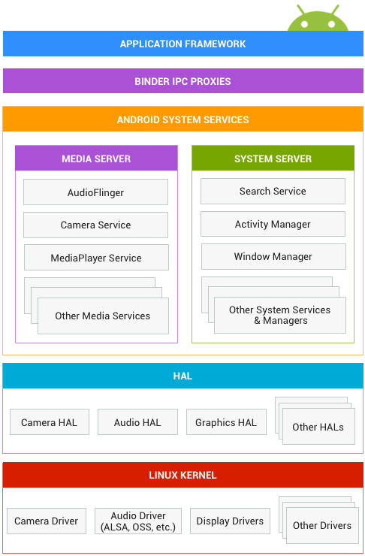
Android System

Slide 7
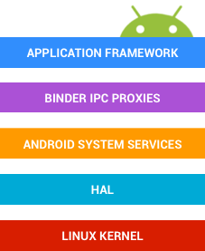
Android System
Your application interacts with the Application Framework.
Some of those frameworks use Inter-Process Communication to cross process boundaries to interact with Android system services.
There are media services, such as Camera and MediaPlayer, and system services, such as ActivityManager and NotificationManager.
These services in turn access the underlying hardware, using the Hardware Abstraction Layer, a standard interface for hardware vendors.
The hardware is ultimately controlled by device drivers based on the Linux kernel.

Slide 8

Android System

Slide 9
Building Blocks
Activities, Views, Intents
Services
Content Providers
Broadcast Receivers
Resources
Safe and Secure

Slide 10
Course Guide
Course Guide:
…
https://pixplicity.gitbooks.io/android-beginners-workshop/

Slide 11
Lesson #1
Android Studio & projects

Slide 12

Android Studio

Slide 13
Getting Started
Course Guide:
Getting Started
Java SDK
Android Studio
Git client (optional)
Ensure everything's up-to-date
Prepare a device

Slide 14
Lesson 1
Course Guide:
Lesson 1
Importing an Android project in Android Studio
The Android Project structure
Gradle build files
AndroidManifest.xml
MainActivity
Resources & layouts

Slide 15
Lesson #2
Activities & Views

Slide 16
Lesson 2
Course Guide:
Lesson 2
Activity launch intent filter
The Activity Life Cycle
Logcat
Click listeners

Slide 17
Activities

Slide 18
Activity lifecycle
Resumed The activity is in the foreground of the screen and has user focus. (This state is also sometimes referred to as "running".)
Paused Another activity is in the foreground and has focus, but this one is still visible. That is, another activity is visible on top of this one and that activity is partially transparent or doesn't cover the entire screen. A paused activity is completely alive (the Activity object is retained in memory, it maintains all state and member information, and remains attached to the window manager), but can be killed by the system in extremely low memory situations.
Stopped The activity is completely obscured by another activity (the activity is now in the "background"). A stopped activity is also still alive (the Activity object is retained in memory, it maintains all state and member information, but is not attached to the window manager). However, it is no longer visible to the user and it can be killed by the system when memory is needed elsewhere.

Slide 19
Activity lifecycle
If an activity is paused or stopped, the system can drop it from memory either by asking it to finish (calling its finish() method), or simply killing its process. When the activity is opened again (after being finished or killed), it must be created all over.

Slide 20
Views / Components / “Widgets”

Slide 21
Listen carefully…
view.setOnClickListener( new onClickListener() { //… } );

Slide 22
Lunch!

Slide 23
Lesson #3
Intents, Tasks & Activity Back Stack

Slide 24
Lesson 3
Course Guide:
Lesson 3

Slide 25
Intents
Explicit intents
Implicit intents

Slide 26
Tasks & Activity Back Stack

Slide 27
Lesson #4
ListViews & Adapters

Slide 28
Lesson 4
Course Guide:
Lesson 4

Slide 29
ListViews & Adapters

Slide 30
Lesson #5
All together now! An image viewing app

Slide 31
Lesson 5
Course Guide:
Lesson 5

Slide 33
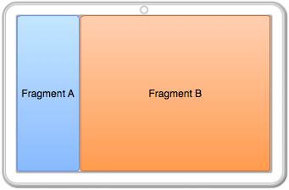
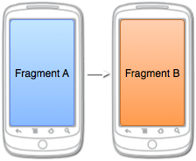
Reusing fragments

Slide 34
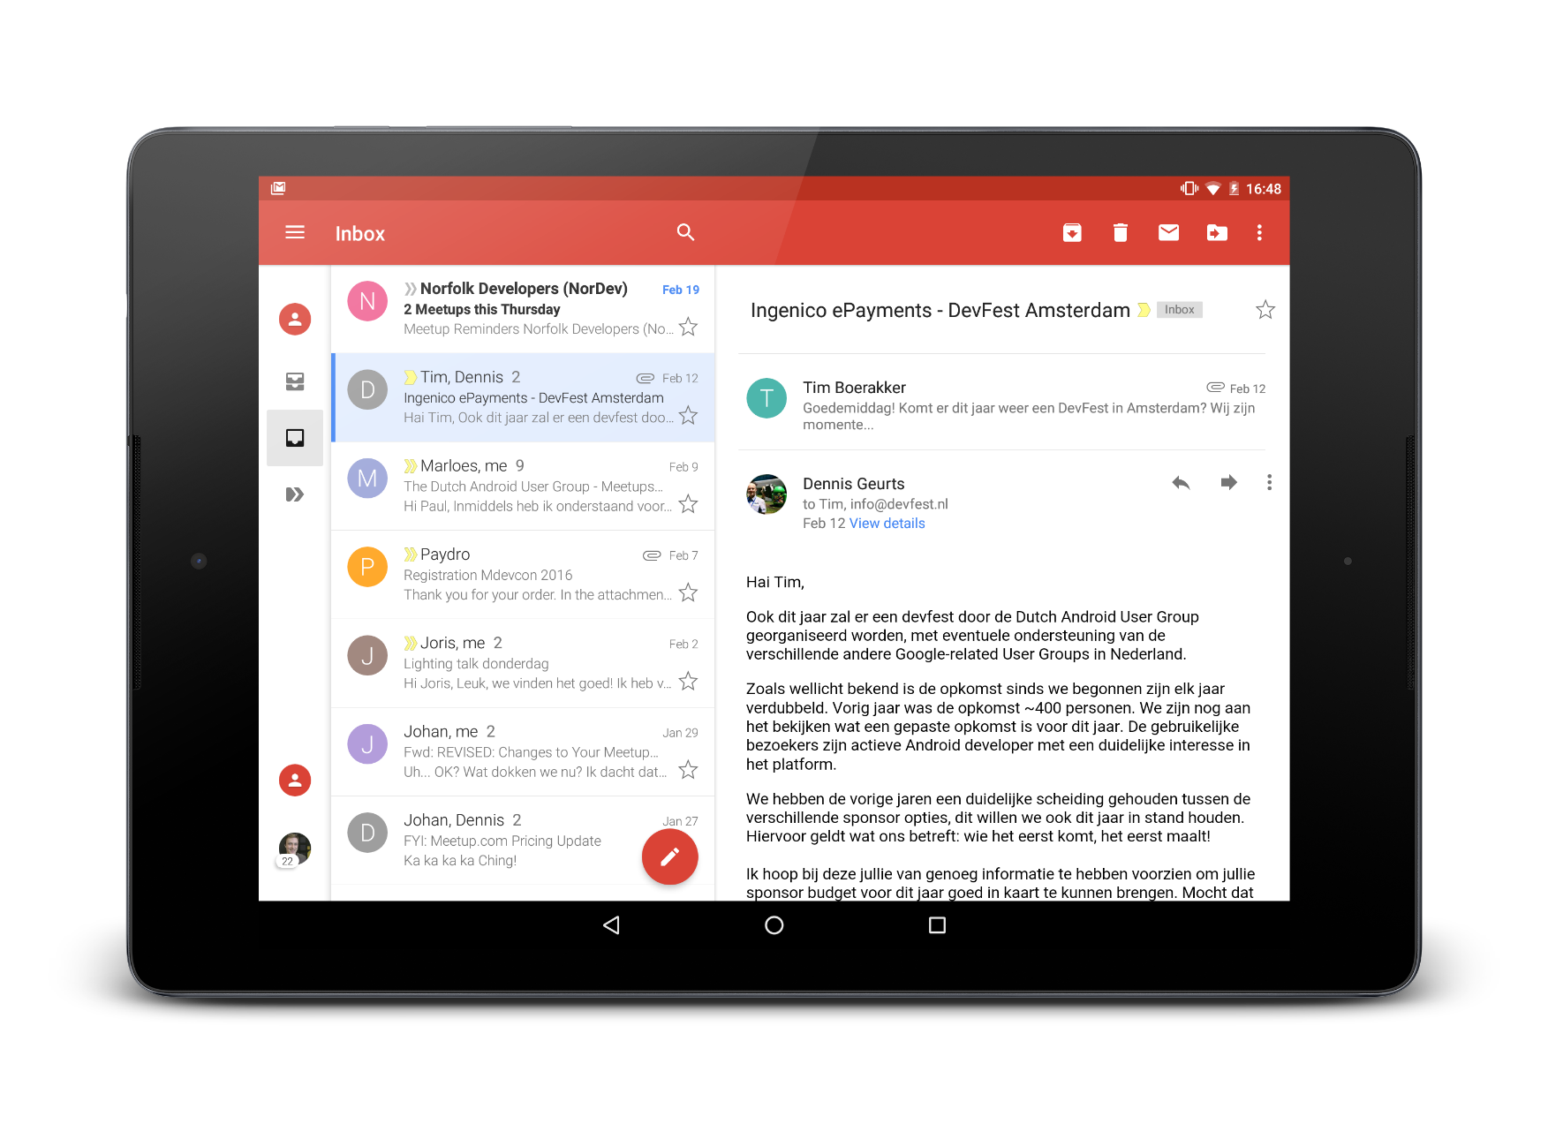
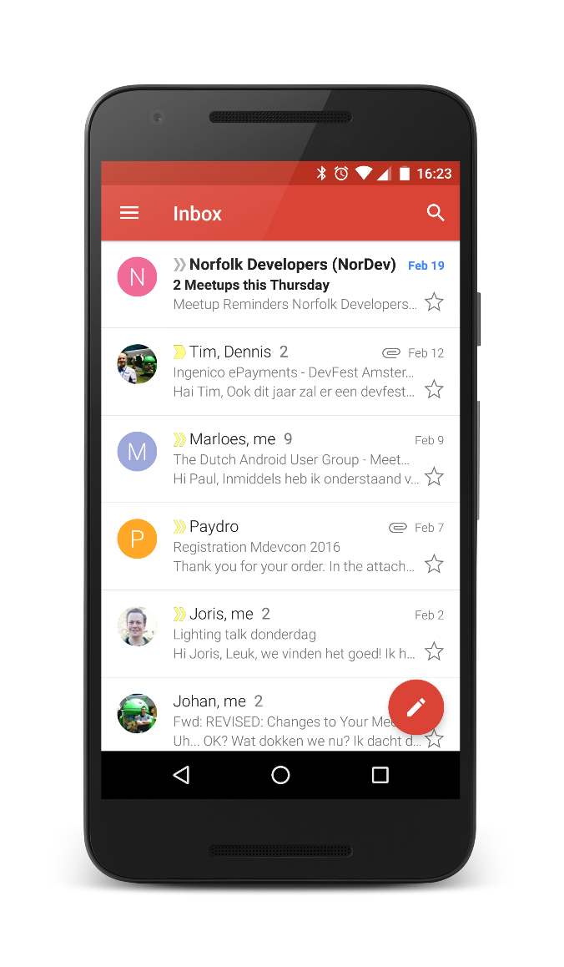
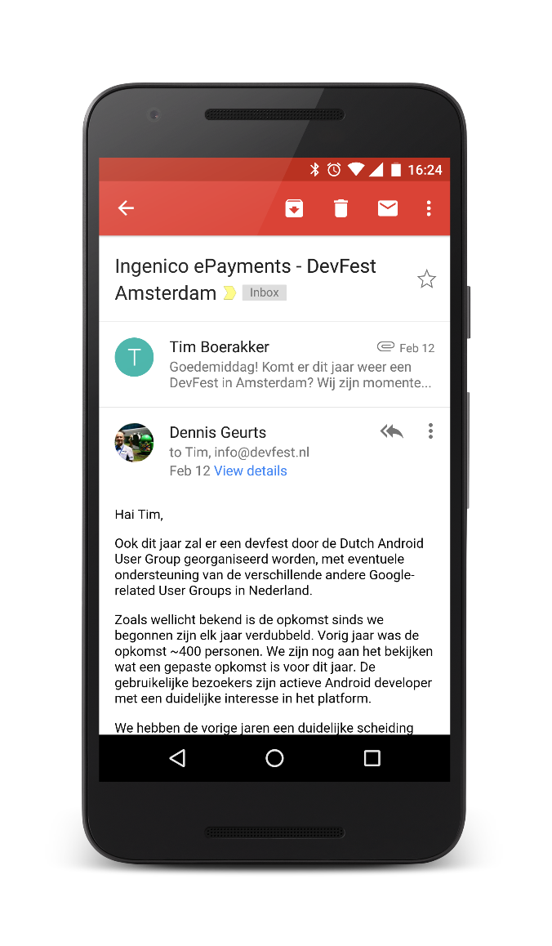
Reusing fragments

Slide 35
Beginner’s Workshop
Paul Lammertsma
CTO, Pixplicity

